Slide 1

MSDS-498 Capstone Executive Summary
Calvin Cronin - Sr. Data Science Analyst
calvincronin2023@u.northwestern.edu

Slide 2
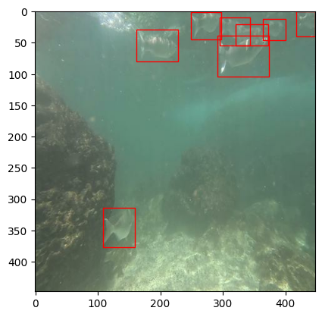
Initial Overview
Mission: At least partially automate the classification and data logging of fish in the Pacific ocean.
Deliverable: A CV(Computer Vision) model capable of recognizing local fish species, deployed with waterproof hardware/camera that can be used in real time in the water.

Slide 3
Project Retrospective
01
Final device is rough around the edges but is aligned with initial expectations.
Final product is consistent with general business and environmental goals.
Achieved what I set out to deliver.
02
I expected an integration nightmare, that was still and underestimation.
Community members or personal connections were there to support me when needed.
The challenges were immense.
03
A very personally rewarding experience.
I’m proud of the end result.
Ultimately I had fun, demonstrated my skills, and learned new ones.

Slide 4
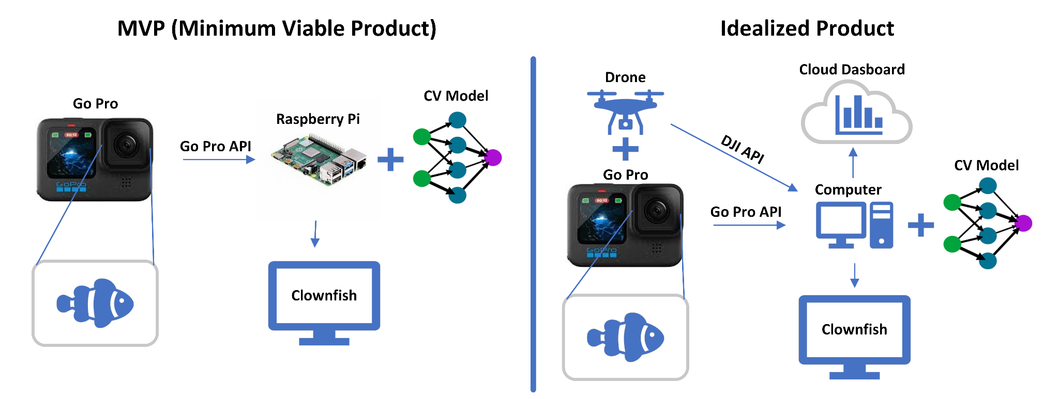
Final Product and Alternatives
(From Initial Overview)

Slide 5
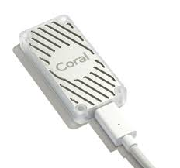
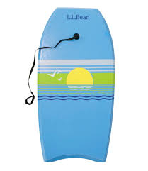
Delivered Final Product
MVP+
Body Board
Google Coral

Slide 6
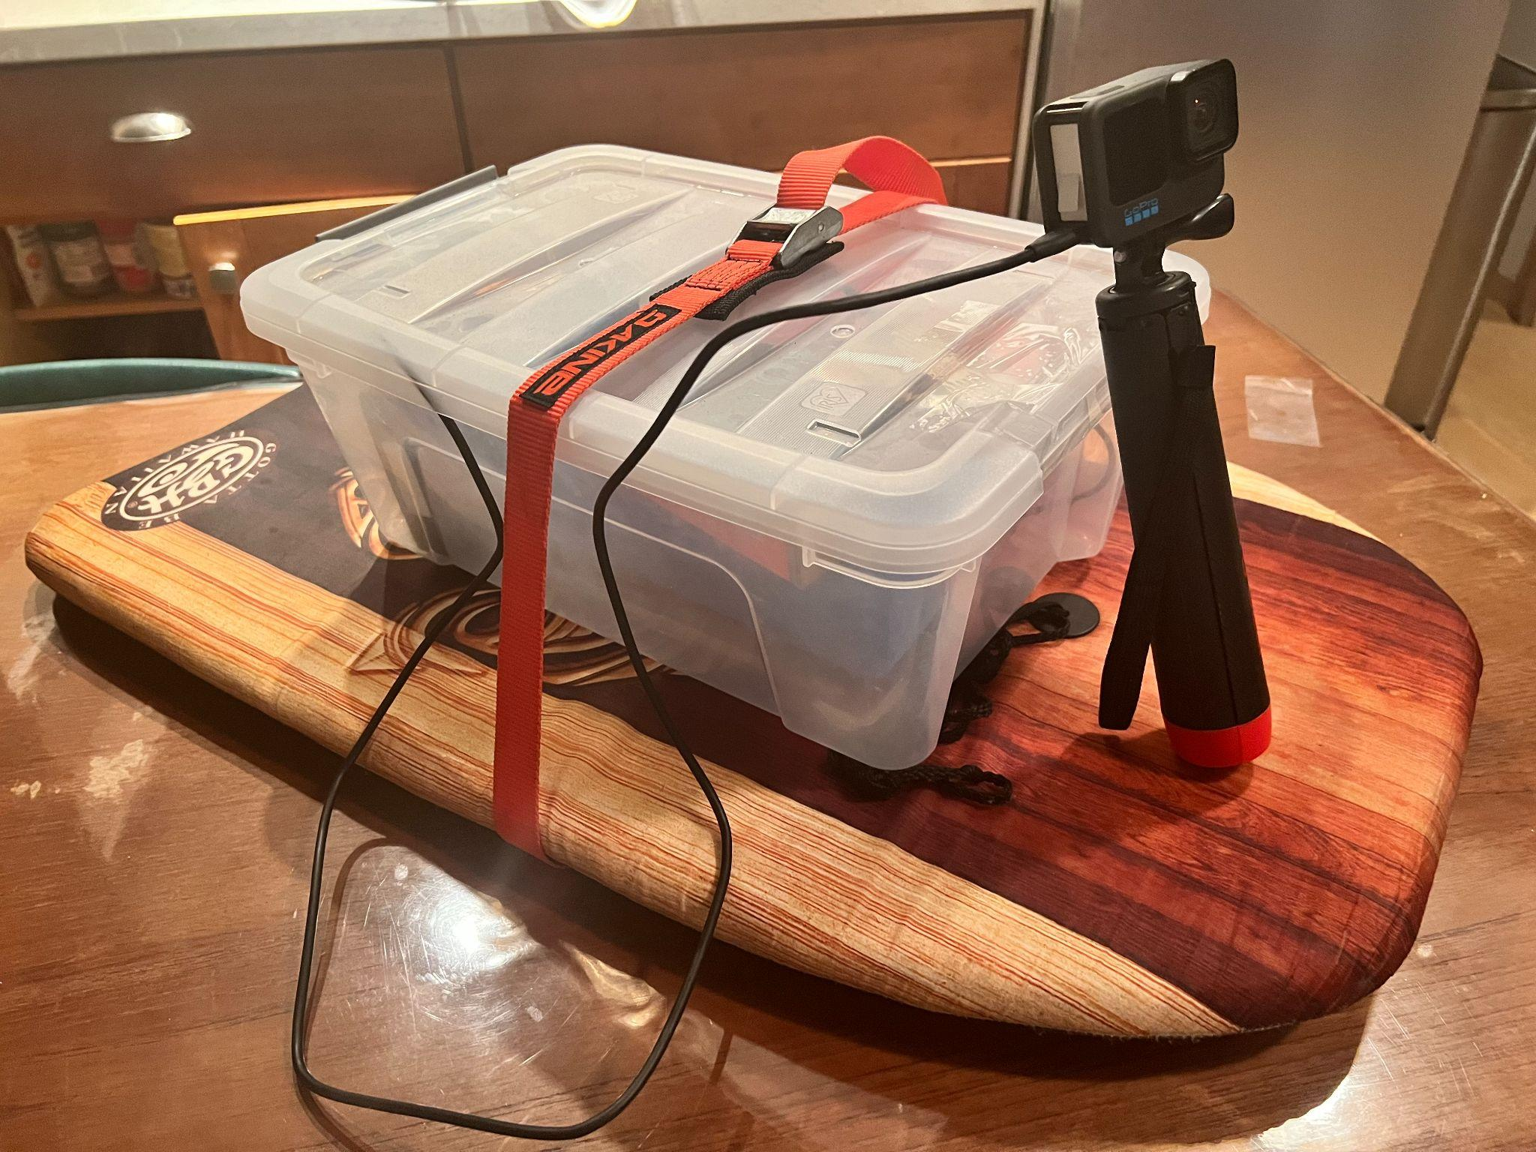
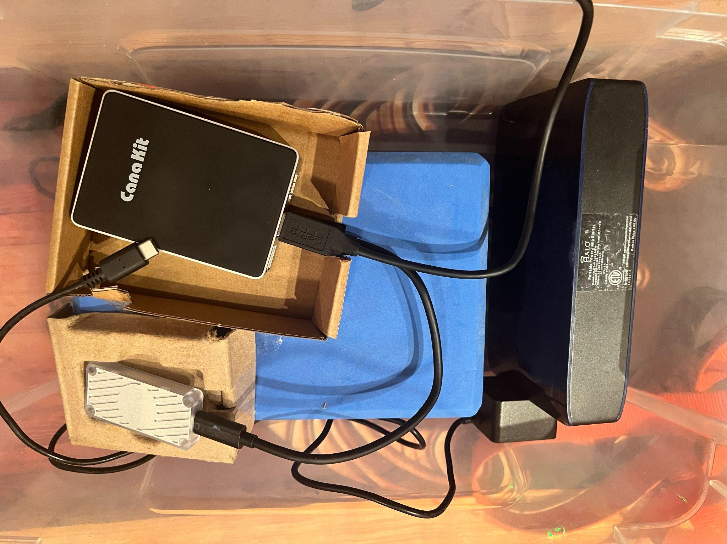
Delivered Final Product Prototype
Raspberry Pi
Power Bank
Google Coral

Slide 7
Business and Environmental Purpose
Component | Cost
Raspberry Pi 4 | $75
GoPro 11 | $350
Google Coral | $80
Body Board and Plastic Tub | $0 (Free on FB Marketplace)
Software | $0 (Open Source or proprietary
Total Cost | ~$505
Comparatively inexpensive to other marine surveillance.
Help researches more efficiently monitor/map marine life.
A commercially available product to increase recreational marine exploration thus garnering support/awareness for marine conservation.

Slide 8
Challenges and Saviors
Challenges
To whom I owe Thanks
Google Open Source code.
Transitionary Period/Siloed
GoPro API
Bad Documentation
Version compatibility
Data Quirks
Color/Visibility/Angle/
Class Balance
Manual Labeling
Detlef Heinze
Went to great lengths to create this walkthrough as a fix to the defunct Google issued one.
Huge thank you to my girlfriend.
Spending hours manually labelling fish pics with me.

Slide 9
Where to Improve (So Many Places)
Form Factor
Size/Aesthetic
Better waterproofing/cooling
Better Model
Accuracy/Performance/Latency
More data, classes, scenarios
Added Features
Cloud Dashboard
Output Screen
Drone integration

Slide 10
Summary
Met the goals that matter, to a degree that’s representative of the timeframe.
Really personally gratifying.
Not as rushed on content.
Great end to my journey here, grateful for the opportunity.
Great addition to my portfolio, and will continue to work on this project on my own.
Congrats to everyone else in the class!

Slide 11
Thank You

